Slide 1
Frinika
SOEN-6471 – Advanced Software Architectures, Winter 2013
Frinika
Final Report
Buthainah Aldosary
Jagdeep Singh
Luiz Mauricio Silva
Mischell Flor
Seun Odutola
April 15th, 2013

Slide 2
Frinika
Table of Contents
Project Overview
Actors and Use Cases
Ideal Architecture
Actual Architecture
Refactorings
Conclusion and Lessons Learnt
Questions

Slide 3
Frinika
Project Overview (1/2)
Frinika is an Open Source software (GPLv2), providing a complete music workstation:
  Music composition
  Mixing
  Recording
  Playback
  Supports synthesizers
Created in 2007.
Currently, there are 3 main developers.
http://sourceforge.net/projects/frinika/

Slide 4
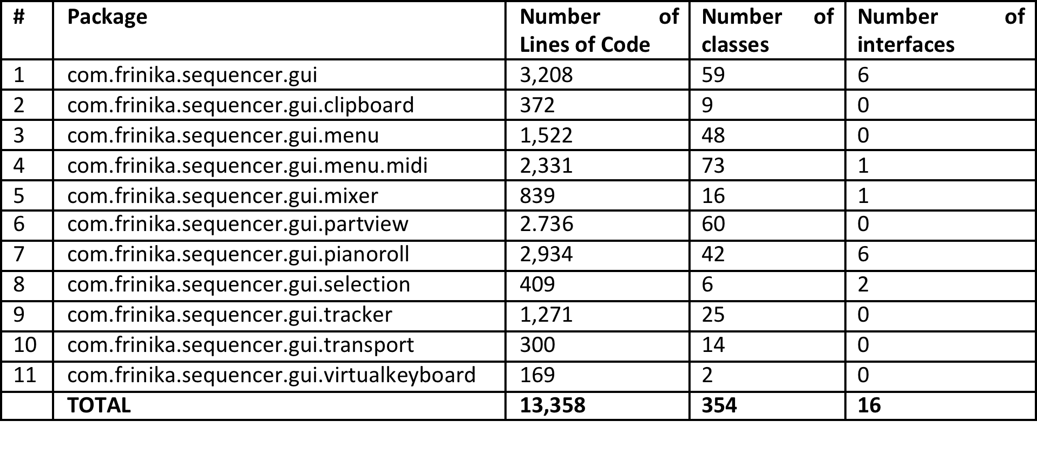
Frinika
Project Overview (2/2)
Frinika has 65,753 LOC; 1,195 classes; 89 interfaces; 133 packages.

Slide 5
Frinika
Actors and Use Cases
Actors:
Musician is a human actor that interacts with the music sequencer (Frinika) to record, compose and mix music tracks and songs.
Use Cases:
UC-001 – Manage Project
UC-002 – Import Music (Midi)
UC-003 – Synchronize Tracks
UC-004 – Compose Track
UC-005 – Edit Track
UC-006 – Manage Notes
UC-007 – Select Synthesizer
UC-008 – Record Track
UC-009 – Mix Music into Midi
UC-010 – Mix Music into Audio

Slide 6
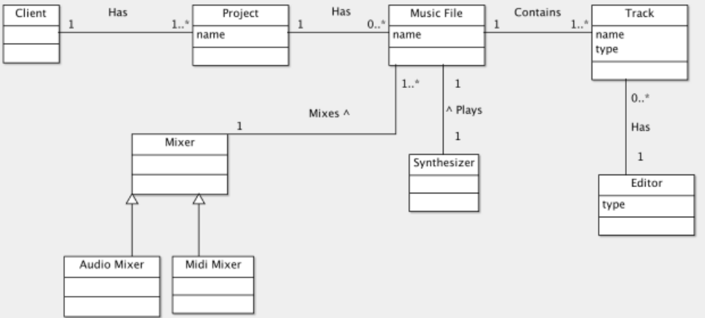
Frinika
Ideal Architecture (Domain Diagram)
Notes:
The client can create a project that can initially be empty or contains one or more music files. Each music file is composed of multiple tracks of different types (e.g. voice, piano, bass). For every track there is an editor to view and alter the tracks. A music file can be played using the synthesizer and also be mixed with other music files using the audio or midi mixer.

Slide 7
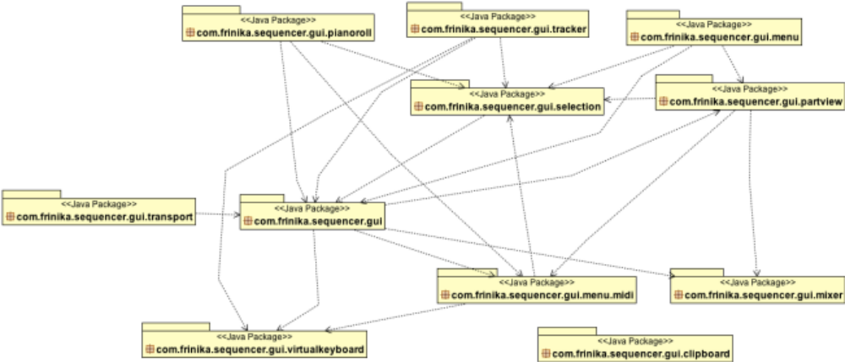
Frinika
Actual Architecture (Package Diagram)
Editor
Project
Track
Music
Track
Mixer
Editor
Notes:
Package -> Concept mappings:
PianoRoll, Tracker, VirtualKeyboard -> Editor
Mixer -> Mixer
PartView, Menu.Midi -> Track
Transport (player controls) -> actions within Music
Menu -> Project
Focus on 2 packages: PianoRoll and Tracker.

Slide 8
Frinika
Refactorings
…

Slide 9
Frinika
Conclusion and Lessons Learnt
…

Slide 10
Frinika
Questions
Questions
?

Slide 11
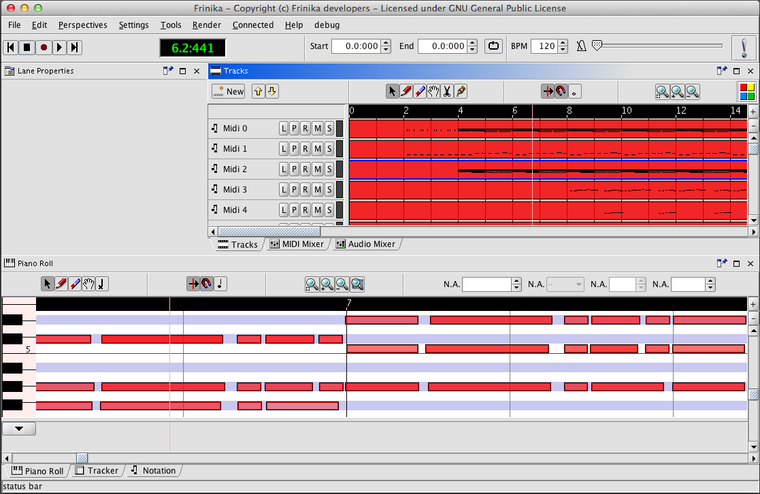
Frinika
Screenshot

